Slide 1
18-349: Introduction to Embedded Real-Time Systems
Lecture 8: ADC and DAC*
Anthony Rowe
Electrical and Computer Engineering
Carnegie Mellon University
* Slides based off of Prabal Dutta at University of Michigan’s embedded course.

Slide 2
Administrivia
Lab 1
1 weeks away!

Slide 3
Last Lecture
ARM optimizations

Slide 4
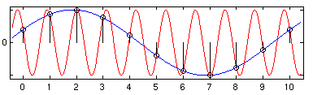
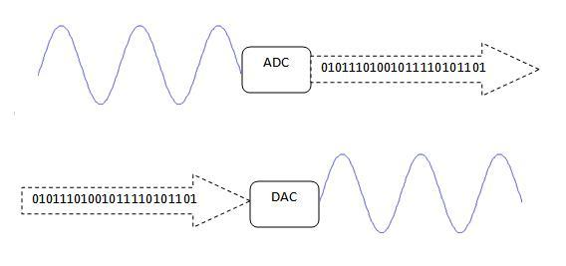
Lecture Overview
Analog to Digital Converters
Digital to Analog Converters

Slide 5
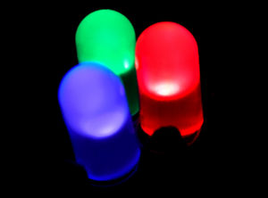
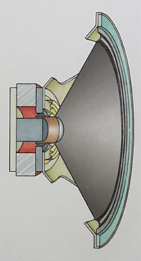
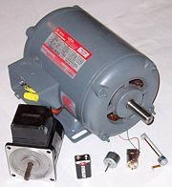
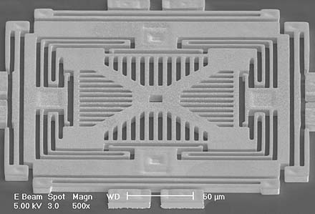
We live in an analog world
Everything in the physical world is an analog signal
Sound, light, temperature, pressure
Need to convert into electrical signals
Transducers: converts one type of energy to another
Electro-mechanical, Photonic, Electrical, …
Examples
Microphone/speaker
Thermocouples
Accelerometers

Slide 6
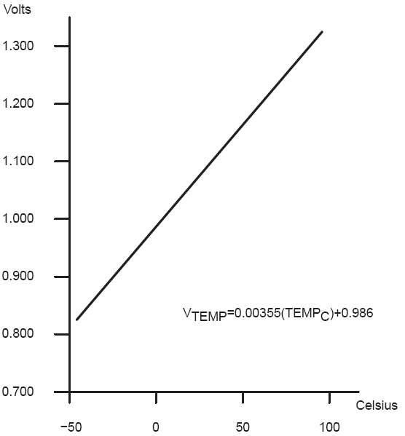
Transducers convert one form of energy into another
Transducers
Allow us to convert physical phenomena to a voltage potential in a well-defined way.
A transducer is a device that converts one type of energy to another. The conversion can be to/from
electrical, electro-mechanical, electromagnetic, photonic, photovoltaic, or any other form of energy.
While the term transducer commonly implies use as a sensor/detector, any device which converts energy
can be considered a transducer. – Wikipedia.

Slide 7
Going from analog to digital
What we want
How we have to get there
Physical
Phenomena
Engineering Units
Physical
Phenomena
Voltage or
Current
ADC Counts
Engineering Units
Sensor
ADC
Software

Slide 8
Representing an analog signal digitally
How do we represent an analog signal?
As a time series of discrete values
→ On MCU: read the ADC data register periodically
V
Counts
8

Slide 9
Choosing the horizontal range
What do the sample values represent?
Some fraction within the range of values
→ What range to use?
Range Too Small
Range Too Big
Ideal Range
9

Slide 10
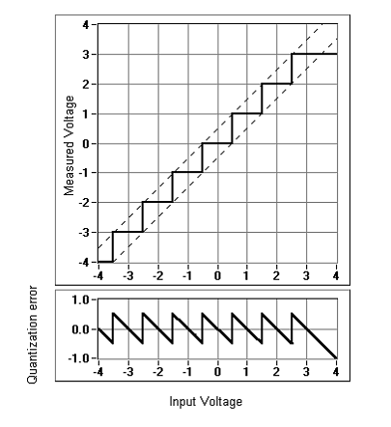
Choosing the horizontal granularity
Resolution
Number of discrete values that represent a range of analog values
MSP430: 12-bit ADC
4096 values
Range / 4096 = Step
Larger range ➔ less information
Quantization Error
How far off discrete value is from actual
½ LSB → Range / 8192
Larger range ➔ larger error
10

Slide 11
Choosing the sample rate
What sample rate do we need?
Too little: we can’t reconstruct the signal we care about
Too much: waste computation, energy, resources
11

Slide 12
Shannon-Nyquist sampling theorem
If a continuous-time signal contains no frequencies higher than , it can be completely determined by discrete samples taken at a rate:
Example:
Humans can process audio signals 20 Hz – 20 KHz
Audio CDs: sampled at 44.1 KHz
12

Slide 13
Converting between voltages, ADC counts, and engineering units
Converting: ADC counts ⬄ Voltage
Converting: Voltage ⬄ Engineering Units
13

Slide 14
A note about sampling and arithmetic*
Converting values in 16-bit MCUs
vtemp = adccount/4095 * 1.5;
tempc = (vtemp-0.986)/0.00355;
→ vtemp = 0! Not what you intended
→ tempc = -277 C
Fixed point operations
Need to worry about underflow and overflow
Floating point operations
They can be costly on the node
14
Notes:
$ cat arithmetic.c
#include <stdio.h>
int main() {
int adccount = 2048;
float vtemp;
float tempc;
vtemp = adccount/4095 * 1.5;
tempc = (vtemp-0.986)/0.00355;
printf("vtemp: %f\n", vtemp);
printf("tempc: %f\n", tempc);
}
$ gcc arithmetic.c
$ ./a.out
vtemp: 0.000000
tempc: -277.746490

Slide 15
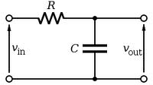
Use anti-aliasing filters on ADC inputs to ensure that Shannon-Nyquist is satisfied
Aliasing
Different frequencies are indistinguishable when they are sampled.
Condition the input signal using a low-pass filter
Removes high-frequency components
(a.k.a. anti-aliasing filter)
15

Slide 16
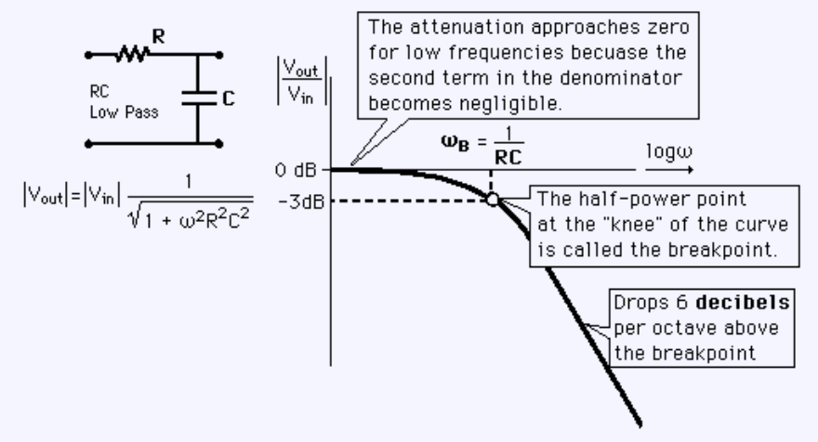
Designing the anti-aliasing filter
Note
ω is in radians
ω = 2πf
Exercise: Say you want the half-power point to be at 30Hz and you have a 0.1 μF capacitor. How big of a resistor should you use?
16
Notes:
53K
2*pi*f = 1 / (R * C)
2*pi*30 = 1 / ( R * .1e-6)
R = 53051

Slide 17
Do I really need to condition my input signal?
Short answer: Yes.
Longer answer: Yes, but sometimes it’s already done for you.
Many (most?) ADCs have a pretty good analog filter built in.
Those filters typically have a cut-off frequency just above ½ their maximum sampling rate.
Which is great if you are using the maximum sampling rate, less useful if you are sampling at a slower rate.
17

Slide 18
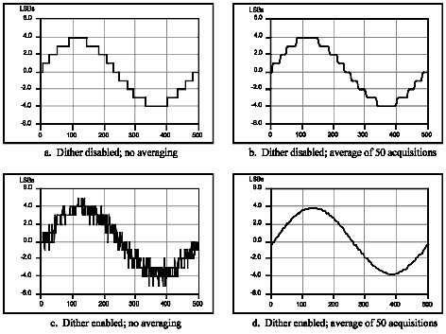
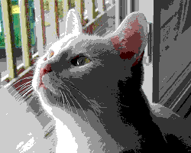

Can use dithering to deal with quantization
Dithering
Quantization errors can result in large-scale patterns that don’t accurately describe the analog signal
Oversample and dither
Introduce random (white) noise to randomize the quantization error.
Direct Samples
Dithered Samples
18

Slide 19
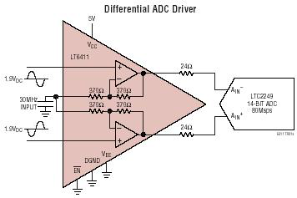
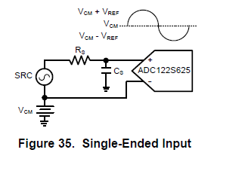
Single-Ended vs Differential
Rail-to-Rail????

Slide 20
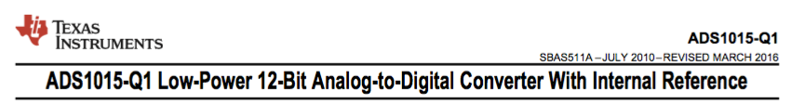
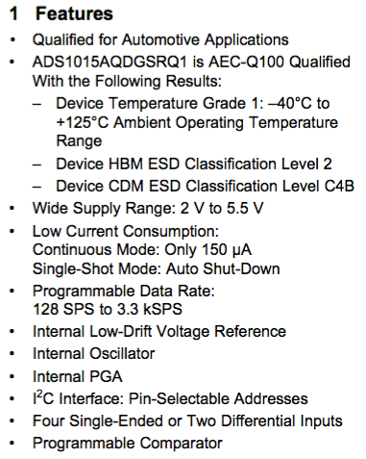
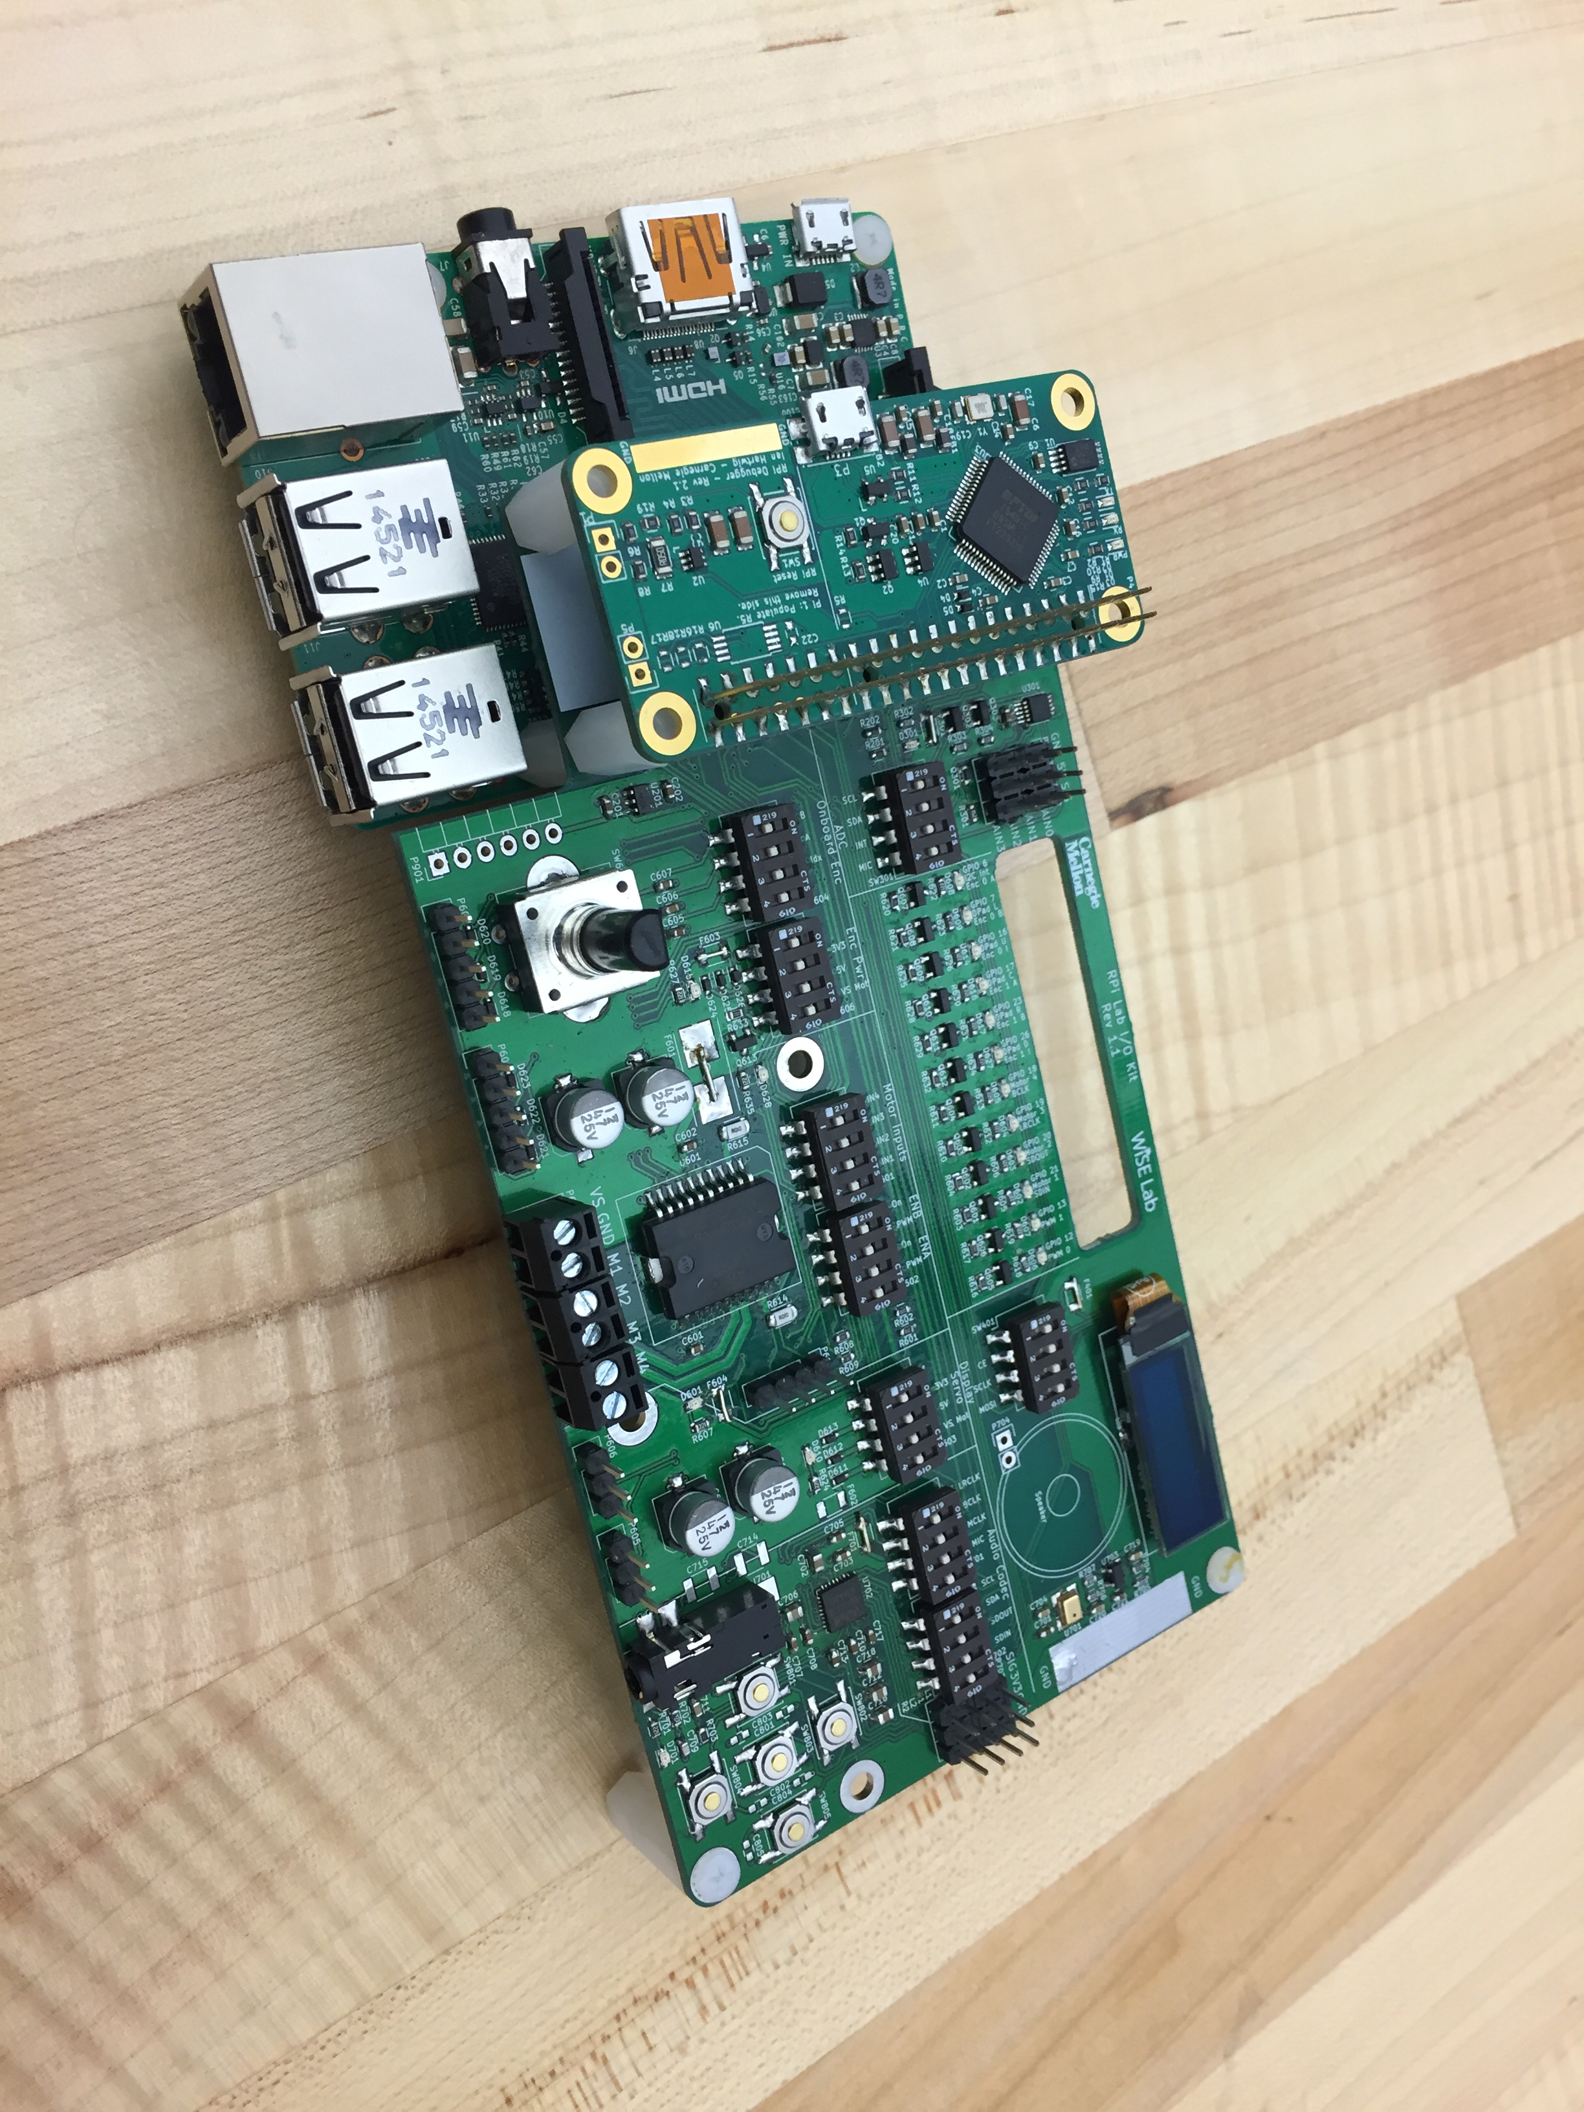
ADS1015 (our friend from lab 1)

Slide 21
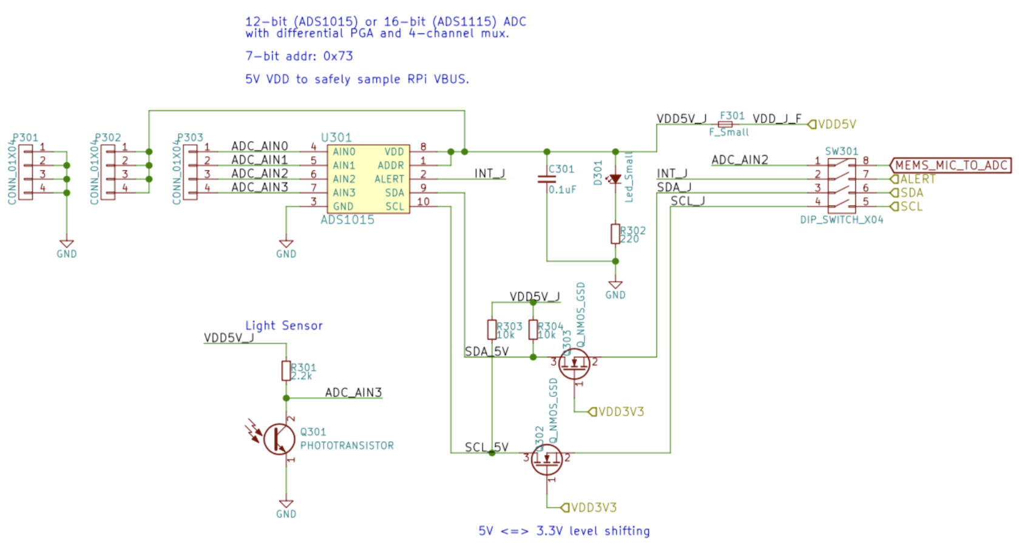
Lab 1 Board

Slide 22
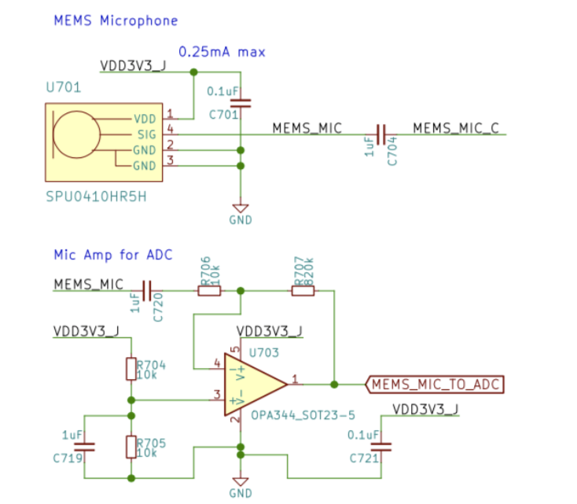
Microphone

Slide 23
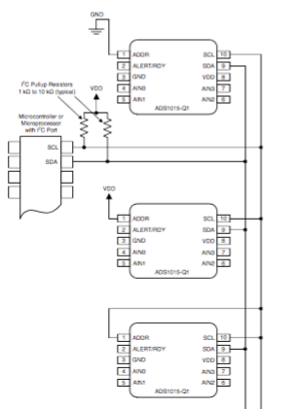
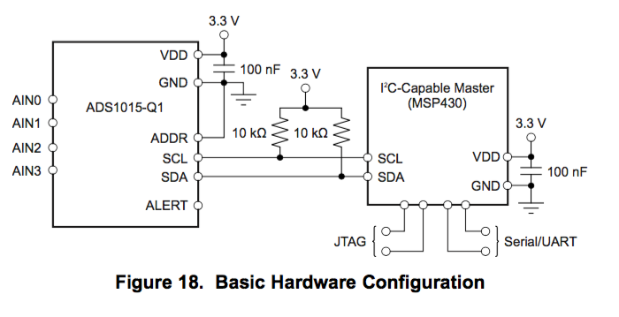
ADS1015

Slide 24
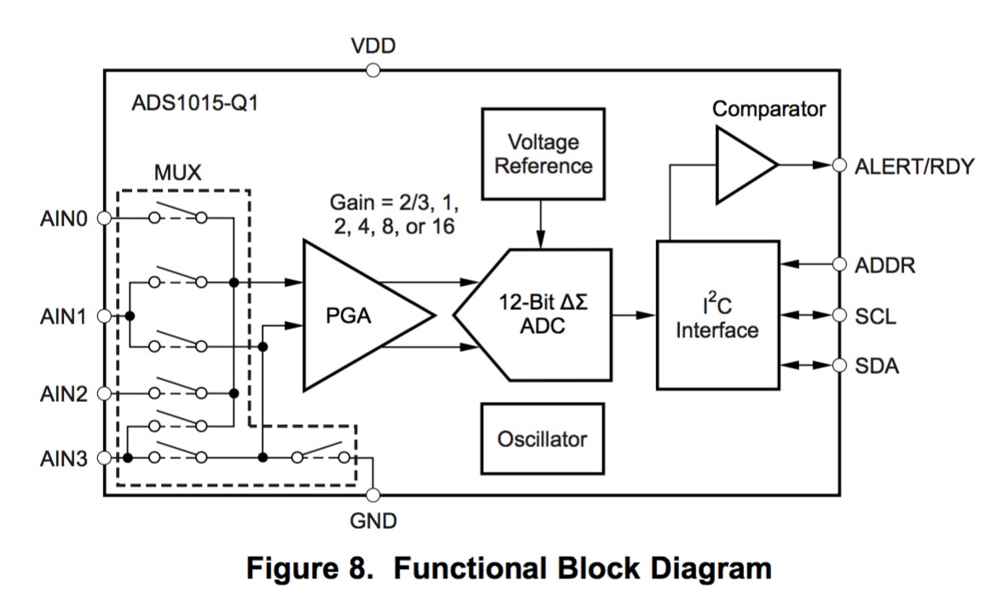
ADS1015

Slide 25
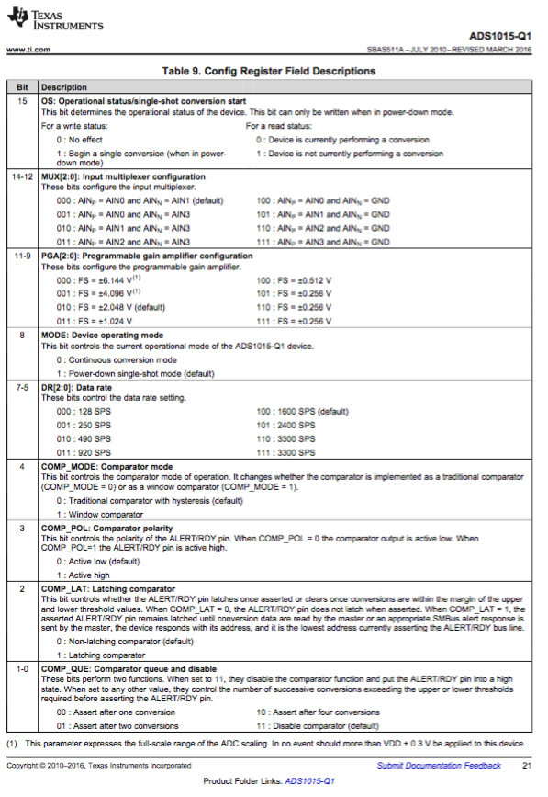
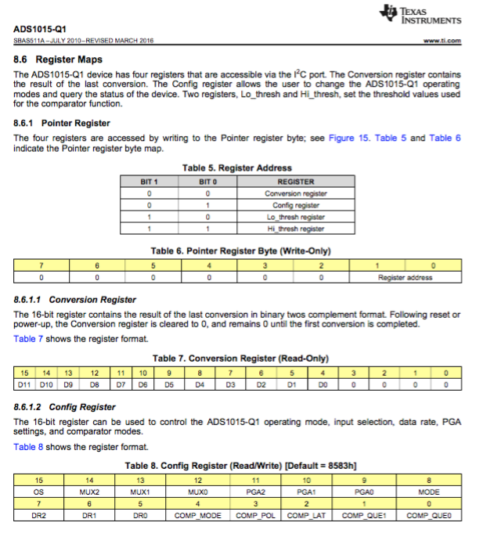
ADS1015 - Reg Maps (RTM)

Slide 26
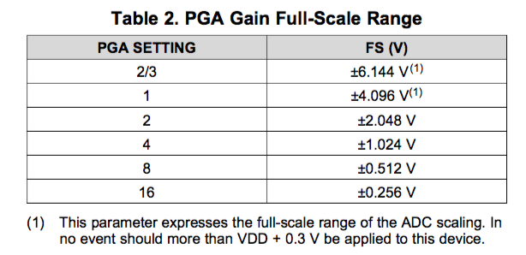
ADS1015 - PGA
Note the programmable gain amplifier (PGA)…

Slide 27
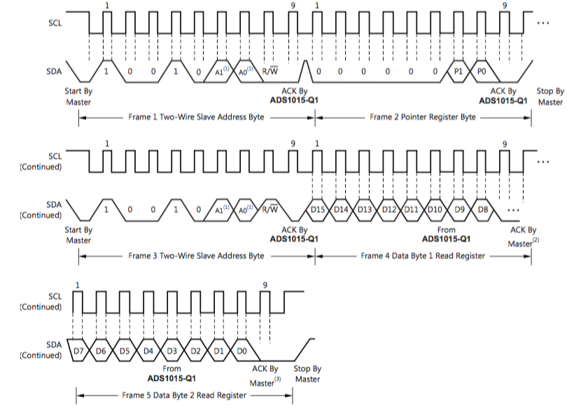
ADS1015 – I2C

Slide 28
Analog to Digital Converter (ADC)
FLASH (parallel) ADC
RAMP Counter ADC
Successive Approximation ADC
Single Slope ADC
Sigma-Delta ADC
Digital World
Real World
(Voltage)
28

Slide 29
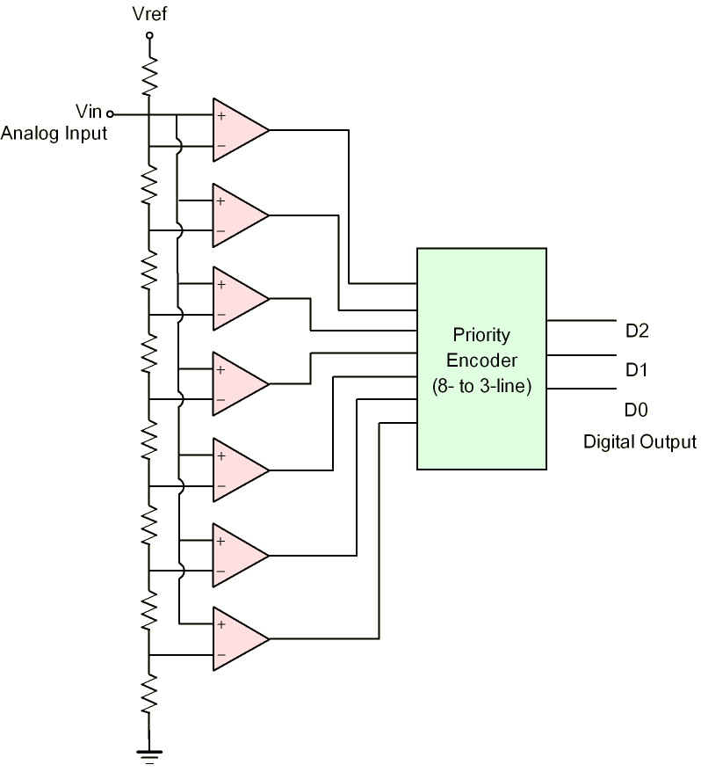
FLASH ADC
+Simple and Fast
-Requires many components
(8 bit requires 255 compares!)
29

Slide 30
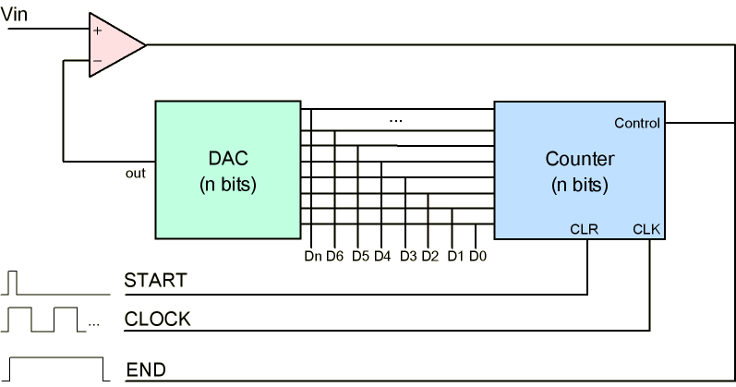
RAMP ADC
Increase value until comparison found
Very slow…
30

Slide 31
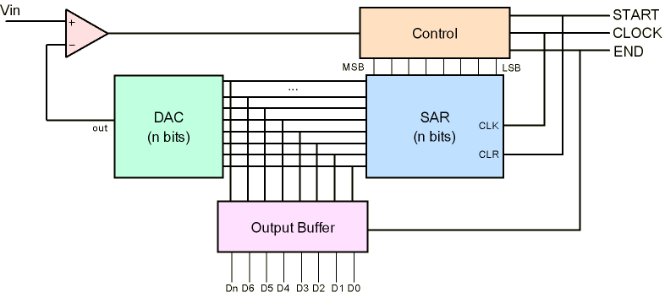
Successive Approximation ADC
Check MSB -> LSB comparisons
Finds value in N cycles for N bits
Most common ADC architecture
31

Slide 32
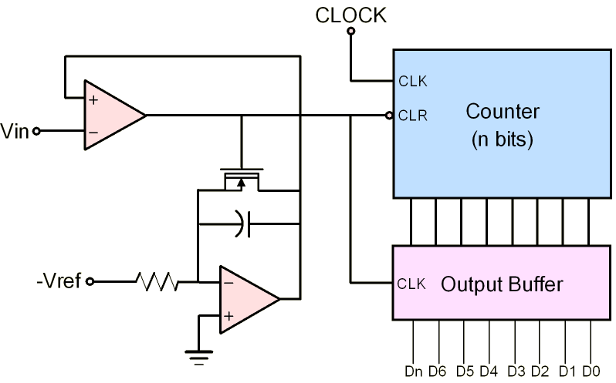
Single-Slope ADC
V_{ref}
time
Similar to a RAMP circuit, but uses a time-based integrator to produce voltage
32

Slide 33
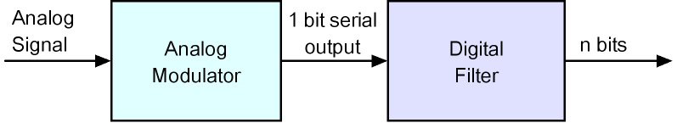
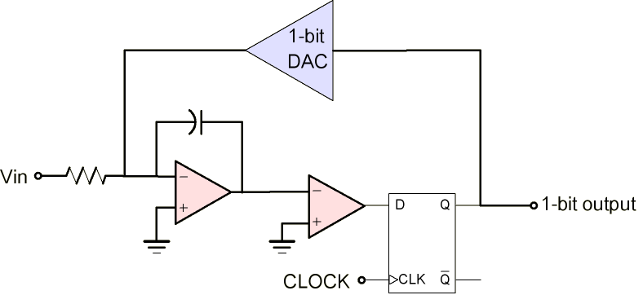
Sigma-Delta ADC
Simple Analog w/ complex digital makes it cheap to manufacture
Accuracy and update rate are good
Similar to ramp ADC, but controlled by 1-bit DAC
33

Slide 34
Digital to Analog Converter (DAC)
PWM DAC
Binary-scaled DAC
Voltage Divider DAC
Digital World
Real World
(Voltage)
34

Slide 35
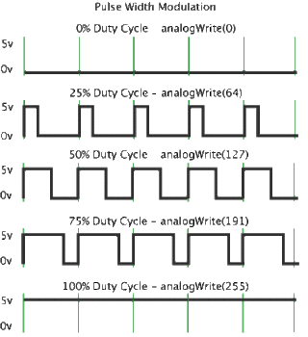
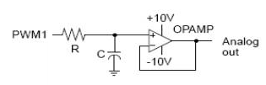
PWM DAC
35

Slide 36
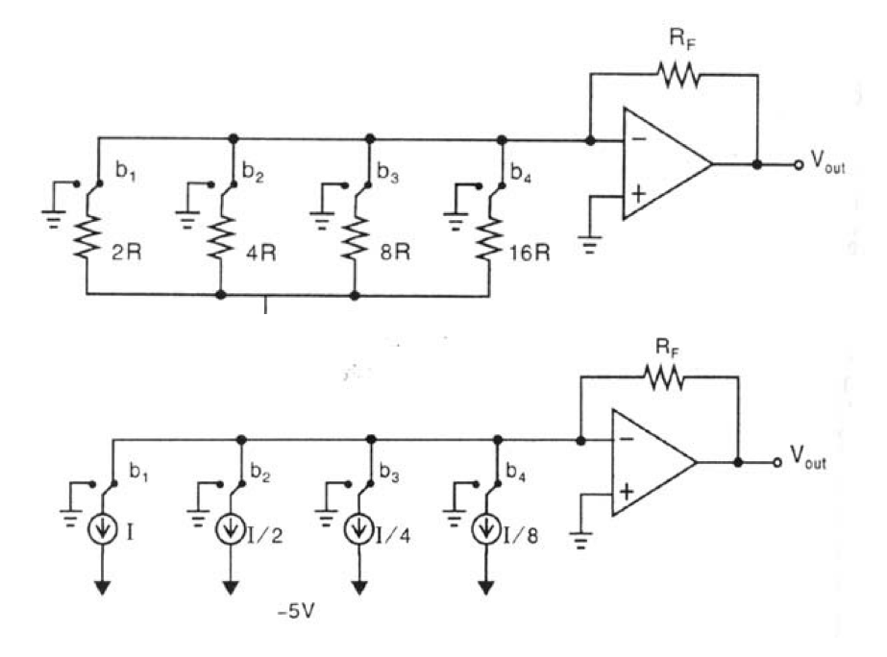
Binary-scaled DAC Architecture
36

Slide 37
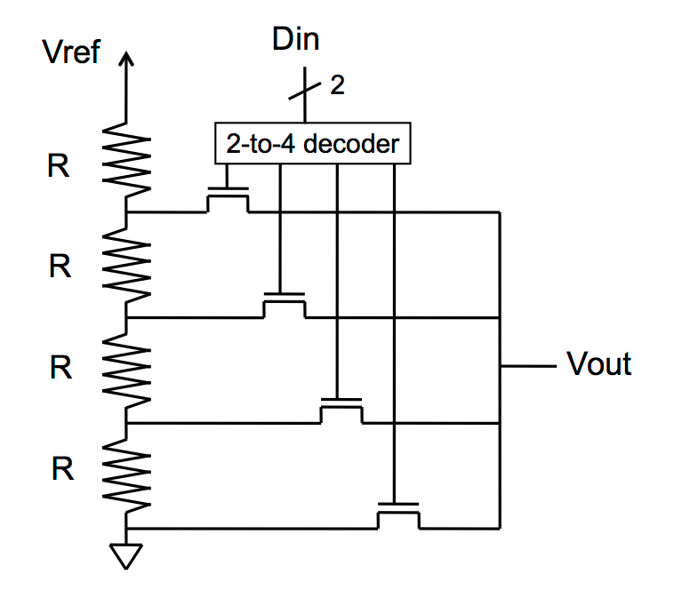
Voltage Divider DAC Architecture
Fast
Size (transistors, switches)?
Accuracy?
Monotonicity?
37

Slide 38
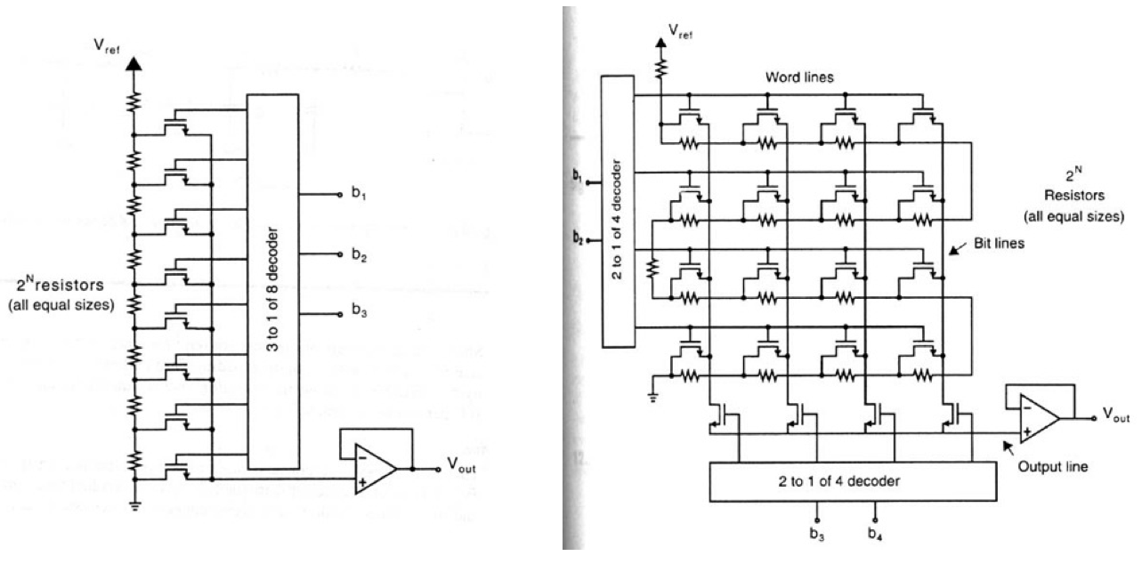
Ladder DAC
38

Slide 39
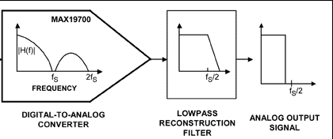
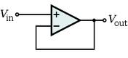
DAC output signal conditioning
Often use a low-pass filter
May need a unity gain op amp for drive strength
39

Slide 40
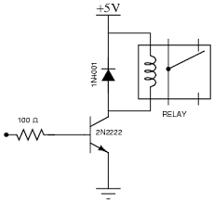
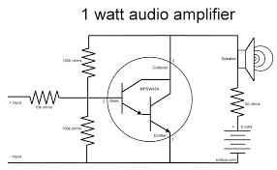
Amplifiers (quick thoughts)
GPIO
Current limit of 20mA
DAC
Even less
Controlling a relay
40

Slide 41
Summary
Analog-to-digital Converters (ADC)
Digital-to-analog Converters (DAC)
Next: Sensors and Actuators

